Slide 1

Real-time detection, tracking, and classification of aerial objects

Slide 2
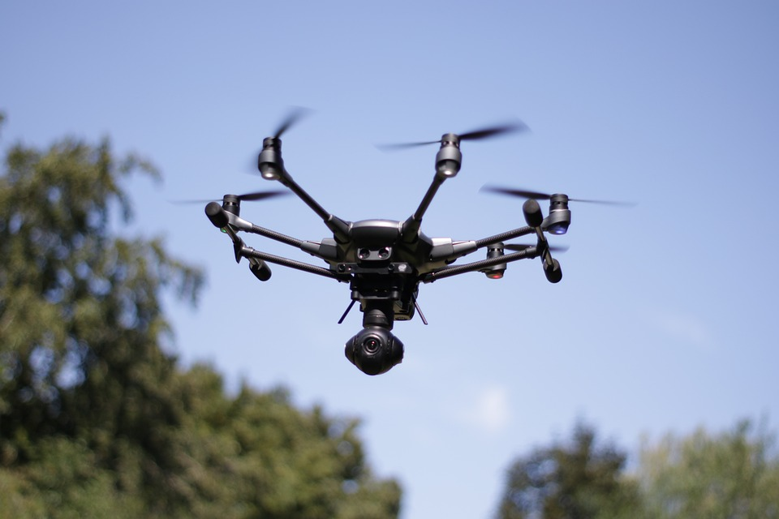
Steps Involved
Data Collection
Data Annotation
Object Detection and Multi-Object Tracking
Feature Extraction for Classification
Object Classification

Slide 3
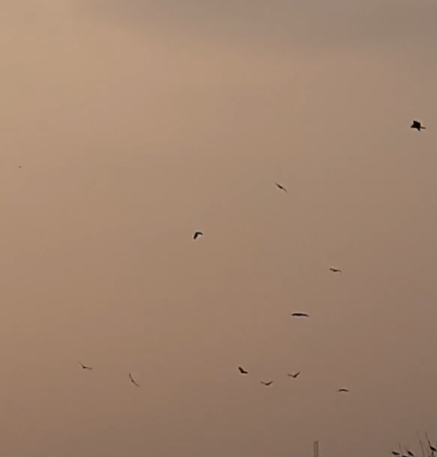
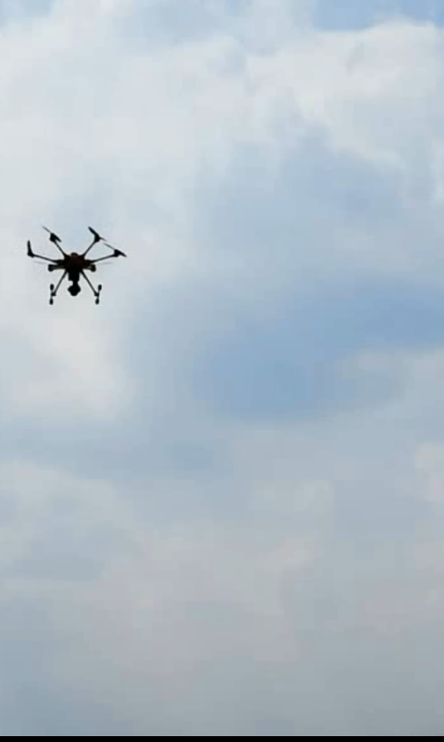
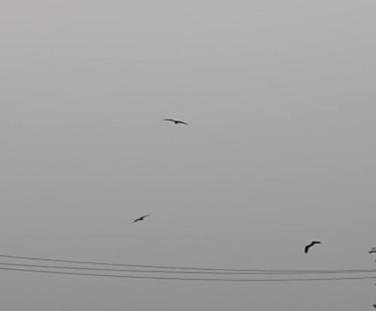
Data collection
Classes: Eagles, Birds(Other birds), Drones
Number of videos collected: 318
Dimensions: 1920 x 1080
Frame rate: 30 FPS
Bound: Minimum possible camera movement.
Sources: Self-recorded, Shutterstock, YouTube, etc.

Slide 4
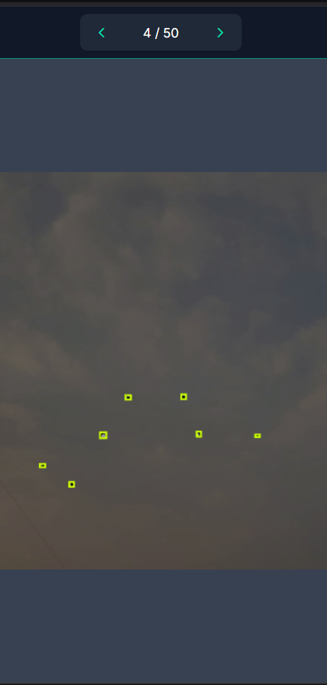
Data annotation
Used Roboflow for data annotation.
Extracted 3 frames per second of each video.
Created labeled image dataset of approximately 1000 images per class.
Augmented the dataset to increase size.

Slide 5
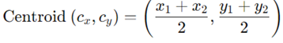
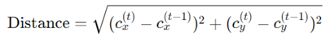
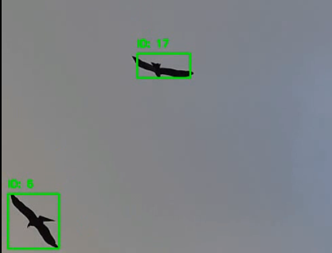
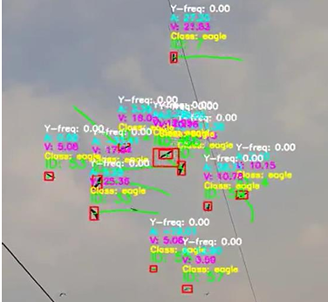
Object Detection and Multi-object tracking
Trained YOLOv5n model for object detection.
The model achieves an overall accuracy of 78.59% in classifying birds, eagles, and drones.
Used Centroid-Based tracking.
Assigned unique IDs to detections across frames using Euclidean Distance.

Slide 6
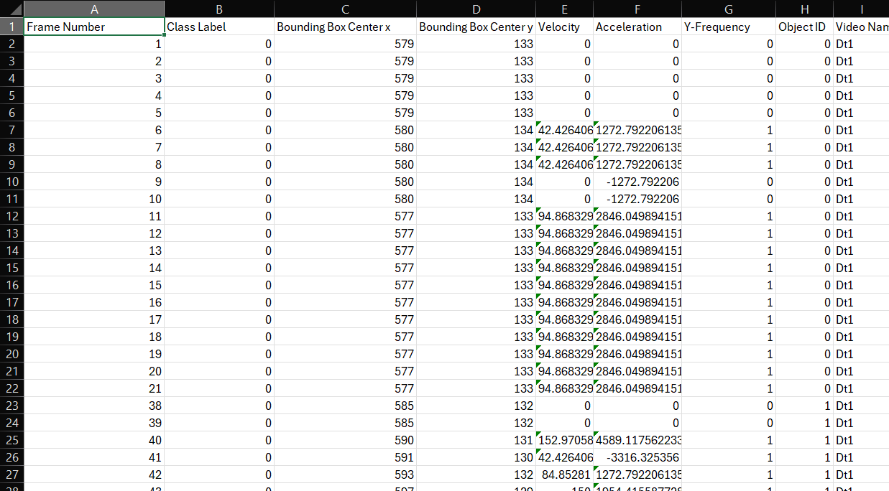
Feature Extraction for classification
For classification using trajectory, we need the following features:
Bounding box center coordinates: These are the coordinates of the objects throughout their appearance in the video.
Velocity: Defined as Distance Covered per frame time.
Acceleration: Change in velocity calculated as Change in velocity per frame time
Y-Frequency: Change in y-coordinated of the object per frame time.
Where, frame time = 1/frame rate.
These features are collected in a CSV file along with frame number, object id, class label, and source video to train classification models.

Slide 7
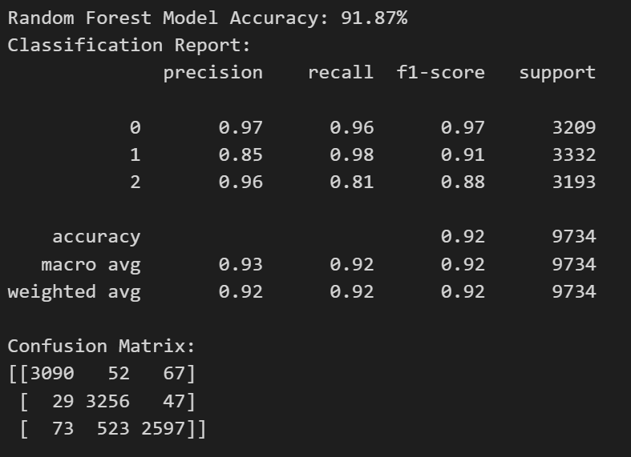
Object Classification
Trained a Random Forest Classification algorithm on features extracted from the videos.
The model is fed data of 5 frames at a time based on which it learns to make class predictions.
We performed normalization of data so that the trained model does become biased towards a specific feature.
We also performed under sampaling , so that equal number of data of each class is used for training to remove biasness towards a specific class.

Slide 8
Comparing Random Forest with other classification models
Model Name | Precision (Avg) | Recall (Avg) | Accuracy
Random Forest | 0.90 | 0.89 | 0.89
SVM | 0.45 | 0.43 | 0.64
KNN | 0.45 | 0.43 | 0.64
Decision Trees | 0.66 | 0.64 | 0.83

Slide 9
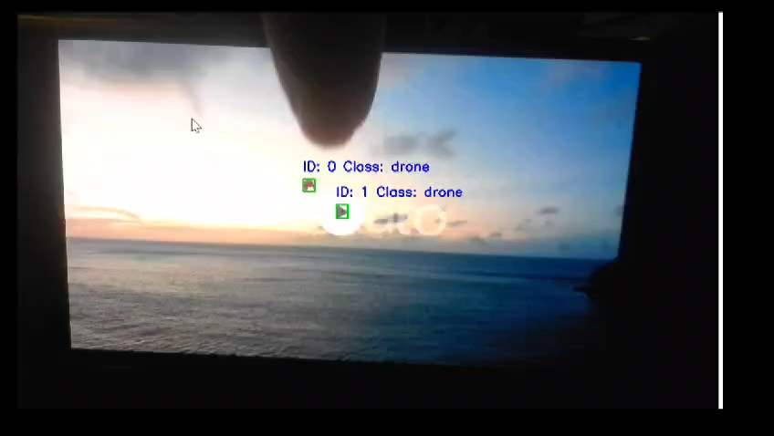
Inferencing the model
To infer the model:
- Select a video or use a live camera feed and detect objects using the YOLO model.
Extract features and store them in a data frame.
Feed the random forest model with features of 5 frames.
Display the output

Slide 10
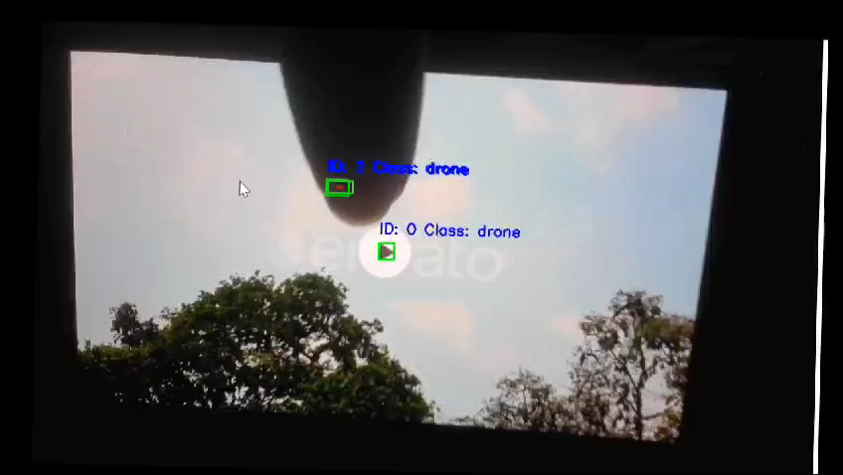
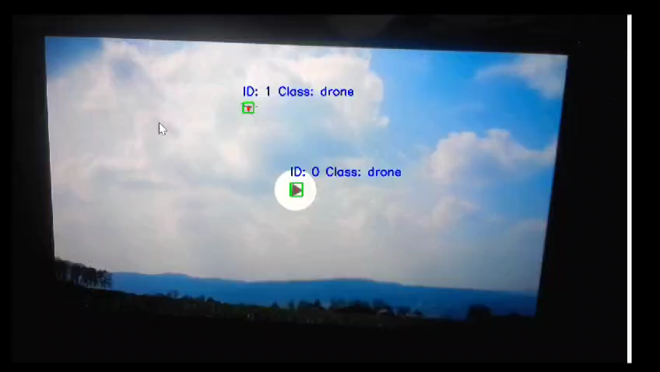
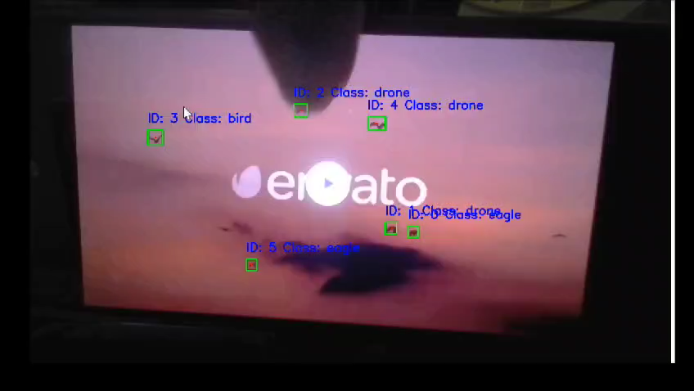
Output

Slide 11

THANK YOU

